Slide 1
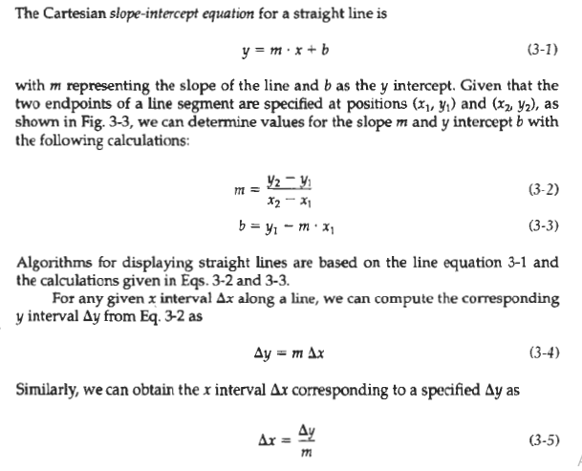
LINE-DRAWING ALGORITHMS:

Slide 2
These equations form the basis for determining deflection voltages in analog devices. For lines with slope magnitudes |m| < 1, Δx can be set proportional to a small horizontal deflection voltage and the corresponding vertical deflection is then set proportional to Δy as calculated from Eq. 3-4.
For lines whose slopes have magnitudes |m| > 1, Δy can be set proportional to a small vertical deflection voltage with the corresponding horizontal deflection voltage set proportional to Δx, calculated from Eq. 3-5.
For lines with m = 1, Δx = Δy and the horizontal and vertical deflections voltages are equal. In each case, a smooth line with slope m is generated between the specified endpoints.

Slide 3
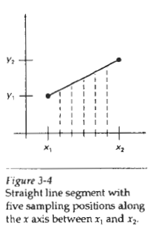
On raster systems, lines are plotted with pixels, and step sizes in the horizontal and vertical directions are constrained by pixel separations. That is, we must "sample" a line at discrete positions and determine the nearest pixel to the line at each sampled position. This scan conversion process for straight lines is illustrated in Fig. 3-4, for a near horizontal line with discrete sample positions along the x axis.

Slide 4
DDA Algorithm:
The digital differential analyzer (DDA) is a scan-conversion line algorithm based on figure 3-4 calculating either Δy or Δx, using Eq. 3-4 or Eq. 3-5. We sample the line at unit intervals in one coordinate and determine corresponding integer values nearest the line path for the other coordinate.
Consider first a line with positive slope, as shown in Fig. 3-3. If the slope is less than or equal to 1, we sample at unit x intervals (Δx = 1) and compute each successive y value as
y_{k+1} = y_{k} + m
Subscript k takes integer values starting from 1, for the first point, and increases by 1 until the final endpoint is reached. Since m can be any real number between 0 and 1, the calculated y values must be rounded to the nearest integer.

Slide 5
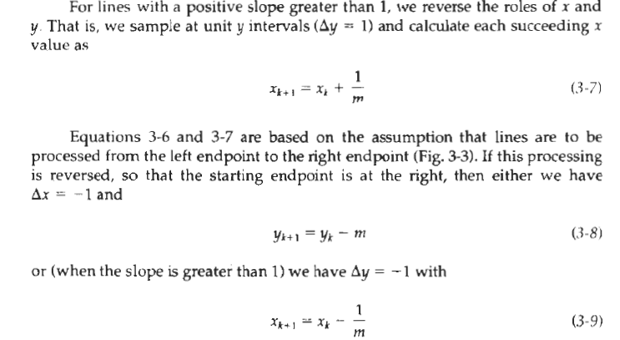
DDA Algorithm:

Slide 6
DDA Algorithm:
Equations 3-6 through 3-9 can also be used to calculate pixel positions along a line with negative slope. If the absolute value of the slope is less than 1 and the start endpoint is at the left, we set Δx = 1 and calculate y values with Eq. 3-6.
When the start endpoint is at the right (for the same slope), we set Δx = -1 and obtain y positions from Eq. 3-8. Similarly, when the absolute value of a negative slope is greater than 1, we use Δy = -1 and Eq. 3-9 or we use Δy = 1 and Eq. 3-7.

Slide 7
DDA Algorithm:
This algorithm is summarized in the following procedure, which accepts as input the two endpoint pixel positions. Horizontal and vertical differences between the endpoint positions are assigned to parameters dx and dy. The difference with the greater magnitude determines the value of parameter steps. Starting with pixel position (x_{a}, y_{a}), we determine the offset needed at each step to generate the next pixel position along the line path.
We loop through this process steps times. If the magnitude of dx is greater than the magnitude of dy and x_{a} is less than x_{b}, the values of the increments in the x and y directions are 1 and m, respectively. If the greater change is in the x direction, but x_{a} is greater than x_{b}, then the decrements -1 and -m are used to generate each new point on the line.
Otherwise, we use a unit increment (or decrement) in the y direction and an x increment (or decrement) of 1/m .

Slide 8
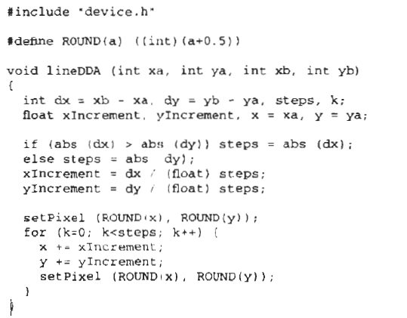
DDA Algorithm:

Slide 9
DDA Algorithm:
The DDA algorithm is a faster method for calculating pixel positions than the direct use of Eq. 3-1. It eliminates the multiplication in Eq. 3-1 by making use of raster characteristics, so that appropriate increments are applied in the x or y direction to step to pixel positions along the line path. The accumulation of roundoff error in successive additions of the floating-point increment, however, can cause the calculated pixel positions to drift away from the true line path for long line segments.
Furthermore, the rounding operations and floating-point arithmetic in procedure lineDDA are still time-consuming. We can improve the performance of the DDA algorithm by separating the increments m and 1/m into integer and fractional parts so that all calculations are reduced to integer operations.

Slide 10
Bresenham's Line Algorithm :
An accurate and efficient raster line-generating algorithm, developed by Bresenham, scan converts lines using only incremental integer calculations that can be adapted to display circles and other curves.
Figures 3-5 and 3-6 illustrate sections of a display screen where straight line segments are to be drawn. The vertical axes show scan-line positions, and the horizontal axes identify pixel columns. Sampling at unit x intervals in these examples, we need to decide which of two possible pixel positions is closer to the line path at each sample step.

Slide 11
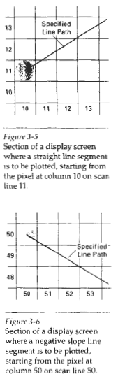
Bresenham's Line Algorithm :
Starting from the left endpoint shown in Fig. 3-5, we need to determine at the next sample position whether to plot the pixel at position (11, 11) or the one at (11, 12). Similarly, Fig. 3-6 shows a negative slope-line path starting from the left endpoint at pixel position (50, 50). In this one, do we select the next pixel position as (51,50) or as (51,49)? These questions are answered with Bresenham's line algorithm by testing the sign of an integer parameter, whose value is proportional to the difference between the separations of the two pixel positions from the actual line path.

Slide 12
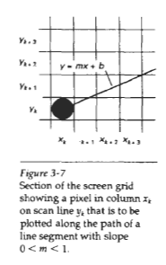
Bresenham's Line Algorithm :
To illustrate Bresenham’s approach, we first consider the scan-conversion process for lines with positive slope less than 1. Pixel positions along a line path are then determined by sampling at unit x intervals. Starting from the left endpoint (x₀, y₀) of a given line, we step to each successive column (x position) and plot the pixel whose scan-line y value is closest to the line path. Figure 3-7 demonstrates the k^{th} step in this process. Assuming we have determined that the pixel at (x_{k}, y_{k}) is to be displayed, we next need to decide which pixel to plot in column x_{k}+1. Our choices are the pixels at positions (x_{k}+1, yk) and (x_{k}+l, y_{k}+l).

Slide 13
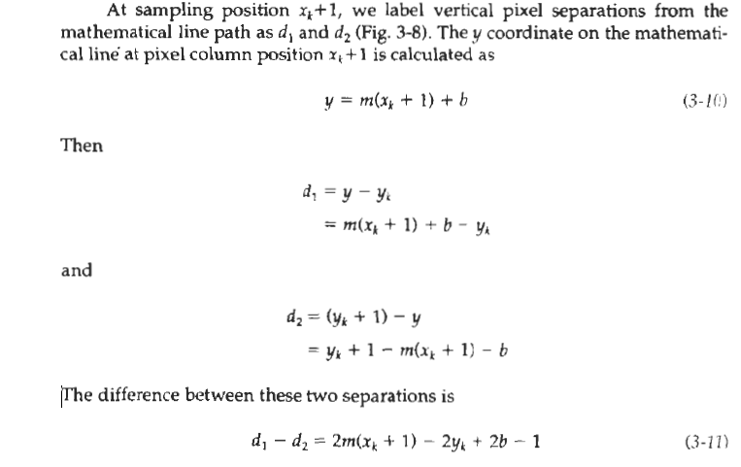
Bresenham's Line Algorithm :

Slide 14

Bresenham's Line Algorithm :
A decision parameter p_{k} for the kth step in the line algorithm can be obtained by rearranging Eq. 3-11 so that it involves only integer calculations.
We accomplish this by substituting m = Δy / Δx, where Δy and Δx are the vertical and horizontal separations of the endpoint positions, and defining:
The sign of p_{k} is the same as the sign of d1 – d2, since Δx > 0 for our example. Parameter c is constant and has the value 2Δy + Δx(2b - l), which is independent of pixel position and will be eliminated in the recursive calculations for p_{k}. If the pixel at y_{k} is closer to the line path than the pixel at y_{k} + 1 (that is, d1 < d2), then decision parameter p_{k} is negative. In that case, we plot the lower pixel; otherwise, we plot the upper pixel.

Slide 15
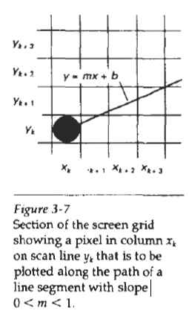
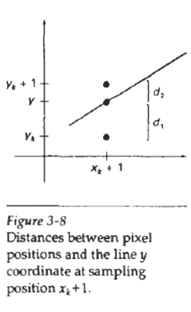
Bresenham's Line Algorithm :

Slide 16
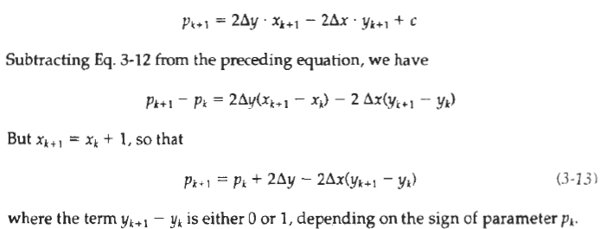
Bresenham's Line Algorithm :
Coordinate changes along the line occur in unit steps in either the x or y directions. Therefore, we can obtain the values of successive decision parameters using incremental integer calculations. At step k + 1, the decision parameter is evaluated from Eq. 3-12 as

Slide 17
Bresenham's Line Algorithm :
This recursive calculation of decision parameters is performed at each integer x position, starting at the left coordinate endpoint of the line. The first parameter, p₀, is evaluated from Eq. 3-12 at the starting pixel position (x₀, y₀) and with m evaluated as Δy / Δx:
P₀ = 2 Δy - Δx …….. ( 3.14 )
We can summarize Bresenham line drawing for a line with a positive slope less than 1 in the following listed steps. The constants 2Δy and 2Δy - 2Δx are calculated once for each line to be scan converted, so the arithmetic involves only integer addition and subtraction of these two constants.

Slide 18
Bresenham's Line Algorithm :
P_{k} = ∆X (d1 – d2)
= ∆X (2 m(X_{k} + 1) - 2 Y_{k} +2b – 1 )
= ∆X (2mX_{k} + 2m - 2 Y_{k} +2b – 1 )
= ∆X (2mX₀ + 2m - 2 Y₀ +2b – 1 ) [put k=0]
= ∆X (2(mX₀ + b - Y₀ ) +2m – 1 )
= ∆X(2m – 1) (Because mX₀ + b - Y₀ =0)
= ∆X (2 ∆Y / ∆X – 1)
P₀ = 2 ∆y - ∆X [decision parameter]

Slide 19
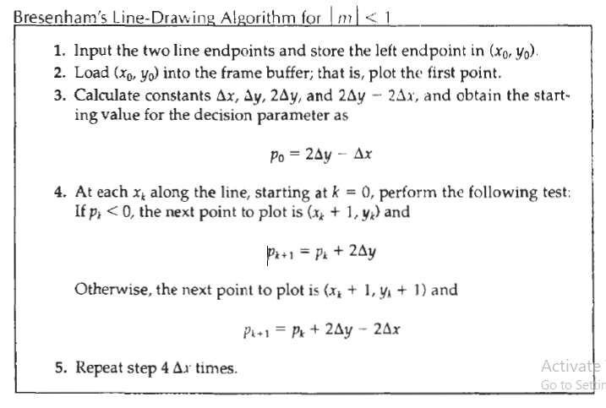
Bresenham's Line Algorithm :

Slide 20
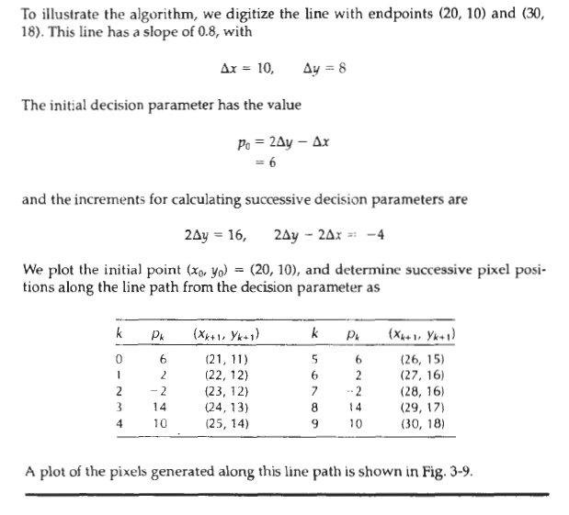
Bresenham's Line Algorithm :

Slide 21
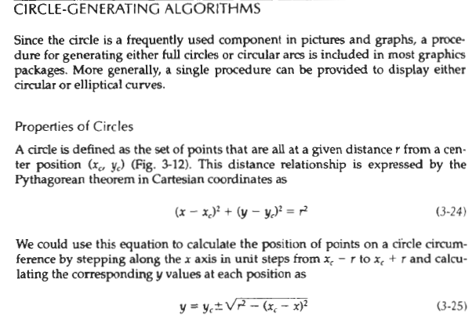
Circle-Generating Algorithms:

Slide 22
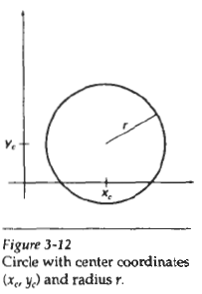
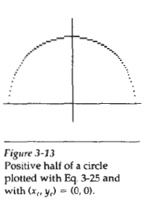
Circle-Generating Algorithms:

Slide 23

Circle-Generating Algorithms:
But this is not the best method for generating a circle. One problem with this approach is that it involves considerable computation at each step. Moreover, the spacing between plotted pixel positions is not uniform, as demonstrated in Fig. 3-13. We could adjust the spacing by interchanging x and y (stepping through y values and calculating x values) whenever the absolute value of the slope of the circle is greater than 1. But this simply increases the computation and processing required by the algorithm.
Another way to eliminate the unequal spacing shown in Fig. 3-13 is to calculate points along the circular boundary using polar coordinates r and θ (Fig.3-12). Expressing the circle equation in parametric polar form yields the pair of equations

Slide 24
Circle-Generating Algorithms:
When a display is generated with these equations using a fixed angular step size, a circle is plotted with equally spaced points along the circumference. The step size chosen for θ depends on the application and the display device. Larger angular separations along the circumference can be connected with straight line segments to approximate the circular path. For a more continuous boundary on a raster display, we can set the step size at 1/r. This plots pixel positions that are approximately one unit apart.

Slide 25
Circle-Generating Algorithms:
Computation can be reduced by considering the symmetry of circles. The shape of the circle is similar in each quadrant. We can generate the circle section in the second quadrant of the xy plain by noting that the two circle sections are symmetric with respect to the y axis. And circle sections in the third and fourth quadrants can be obtained from sections in the first and second quadrants by considering symmetry about the x axis.
We can take this one step further and note that there is also symmetry between octants. Circle sections in adjacent octants within one quadrant are symmetric with respect to the 45⁰ line dividing the two octants. These symmetry conditions are illustrated in Fig.3-14, where a point at position (x, y) on a one-eighth circle sector is mapped into the seven circle points in the other octants of the xy plane. Taking advantage of the circle symmetry in this way we can generate all pixel positions around a circle by calculating only the points within the sector from x = 0 to x = y.

Slide 26
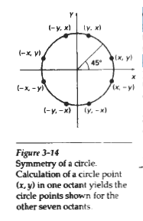
Circle-Generating Algorithms:
Determining pixel positions along a circle circumference using either Eq.
3-24 or Eq. 3-26 still requires a good deal of computation time. The Cartesian equation 3-24 involves multiplications and square-root calculations, while the parametric equations contain multiplications and trigonometric calculations.
More efficient circle algorithms are based on incremental calculation of decision parameters, as in the Bresenham line algorithm, which involves only simple integer operations,

Slide 27
Circle-Generating Algorithms:
Bresenham's line algorithm for raster displays is adapted to circle generation by setting up decision parameters for finding the closest pixel to the circumference at each sampling step. The circle equation 3-24, however, is nonlinear, so that square-root evaluations would be required to compute pixel distances from a circular path. Bresenham's circle algorithm avoids these square-root calculations by comparing the squares of the pixel separation distances.
A method for direct distance comparison is to test the halfway position between two pixels to determine if this midpoint is inside or outside the circle boundary. This method is more easily applied to other conics; and for an integer circle radius, the midpoint approach generates the same pixel positions as the Bresenham circle algorithm. Also, the error involved in locating pixel positions
along any conic section using the midpoint test is limited to one-half the pixel separation.

Slide 28
Midpoint Circle Algorithm:
As in the raster line algorithm, we sample at unit intervals and determine the closest pixel position to the specified circle path at each step. For a given radius r and screen center position (x_{c}, y_{c}), we can first set up our algorithm to calculate pixel positions around a circle path centered at the coordinate origin (0,0). Then each calculated position (x, y) is moved to its proper screen position by adding x_{c} to x and y_{c} to y.
Along the circle section from x = 0 to x = y in the first quadrant, the slope of the curve varies from 0 to -1. Therefore, we can take unit steps in the positive x direction over this octant and use a decision parameter to determine which of the two possible y positions is closer to the circle path at each step.
Positions of the other seven octants are then obtained by symmetry.

Slide 29
Midpoint Circle Algorithm:
To apply the midpoint method, we define a circle function:
f_{circle}(x, y) = x² + y² – r² ………. ( 3-27)
Any point ( x , y) on the boundary of the circle with radius r satisfies the equation f_{circle}(x, y) = 0. If the point is in the interior of the circle, the circle function is negative. And if the point is outside the circle, the circle function is positive.
To summarize, the relative position of any point (x. y) can be determined by checking the sign of the circle function:

Slide 30

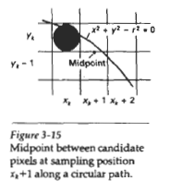
Midpoint Circle Algorithm:

Slide 31
Midpoint Circle Algorithm:
The circle-function tests in 3-28 are performed for the mid positions between pixels near the circle path at each sampling step. Thus, the circle function is the decision parameter in the midpoint algorithm, and we can set up incremental calculations
for this function as we did in the line algorithm.
Figure 3-15 shows the midpoint between the two candidate pixels at sampling position x_{k} + 1. Assuming we have just plotted the pixel at (x_{k}, y_{k}), we next need to determine whether the pixel at position (x_{k}+ 1, y_{k}) or the one at position (x_{k} + 1, y_{k} - 1) is closer to the circle. Our decision parameter is the circle function 3-27 evaluated at the midpoint between these two pixels:

Slide 32
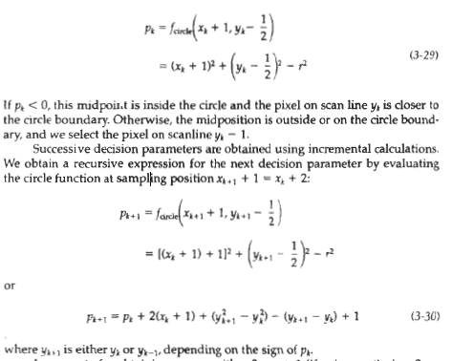
Midpoint Circle Algorithm:

Slide 33
Now find successive decision parameter (P_{k +1})
Replace k as k+1 in eq. no (3)
P_{k +1} = (X_{k+1}+1)² + (Y_{k+1} – ½)² – r²
P_{k +1} =(X_{k} +2)² + (Y_{k+1} – ½)² – r² …(4)
Now,
P_{k +1} – P_{k} = [(X_{k} +2)² + (Y_{k+1} – ½)² – r² ] – [(X_{k}+1)² + (Y_{k} – ½)² – r²]
P_{k +1} = P_{k} + 2(X_{k} +1) + (Y²_{k+1} - Y²_{k} ) - (Y_{k+1} - Y_{k} ) + 1 …(5)
Where Y_{k+1} is either Y_{k} or Y_{k-1}

Slide 34
if P_{k} < 0 then midpoint is inside the circle and pixel on scan line Y_{k} is closer to the circle boundary. So select upper pixel. i.e. Y_{k}
Then from eq. no (5)
P_{k +1} = P_{k} + 2(X_{k} +1) + (Y²_{k+1} - Y²_{k} ) - (Y_{k+1} - Y_{k} ) + 1
P_{k +1} = P_{k} + 2(X_{k} +1) + (Y²_{k} - Y²_{k} ) - (Y_{k} - Y_{k} ) + 1
= P_{k} + 2(X_{k} +1) + 1
P_{k +1} = P_{k} + 2X_{k} + 3
Now if P_{k} ≥ 0 then mid point is on the circle boundary or outside the circle boundary. So select lower pixel. i.e.Y_{k-1}
Then from eq. no (5)
P_{k +1} = P_{k} + 2(X_{k} +1) + (Y²_{k+1} - Y²_{k} ) - (Y_{k+1} - Y_{k} ) + 1
P_{k +1} = P_{k} + 2(X_{k} +1) + (Y_{k} -1)² - Y²_{k} ) - (Y_{k} -1 - Y_{k} ) + 1
P_{k +1} = P_{k} + 2(X_{k} – Y_{k} ) + 5

Slide 35
The initial decision parameter is obtained by evaluating the circle function at the start position (x0,y0) = (0,r).
First decision parameter coordinate at (0,r)
P₀ = f_{circle}( 1, r – ½ )
P₀ = (0 + 1)² + (r – ½ )² –r²
P₀ = 5/4 – r
but Bresenham algorithm involve only integer value
P₀ = 1 – r …(6)

Slide 36
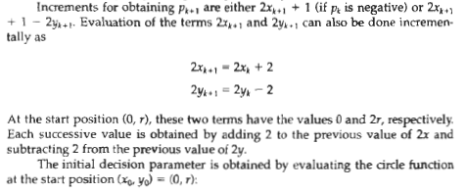
Midpoint Circle Algorithm:

Slide 37
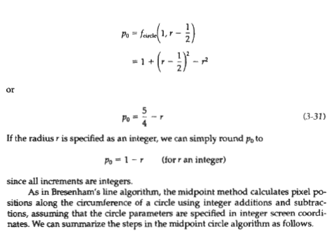
Midpoint Circle Algorithm:

Slide 38
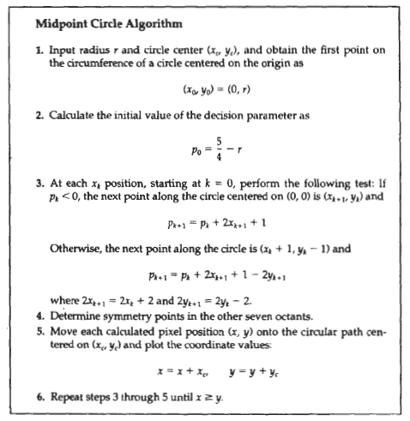
Midpoint Circle Algorithm:

Slide 39
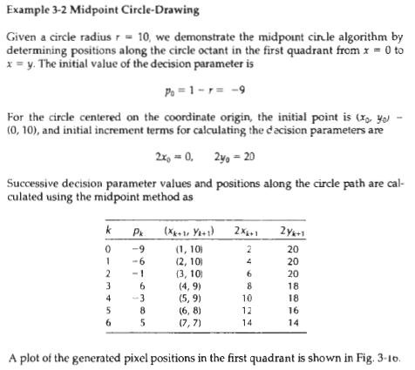
Midpoint Circle Algorithm:

Slide 40
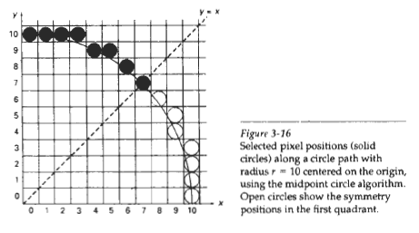
Midpoint Circle Algorithm:

Slide 41
Character Generation:
Letters, numbers, and other characters can be displayed in a variety of sizes and styles. The overall design style for a set (or family) of characters is called a type face. Today, there are hundreds of typefaces available for computer applications.
Examples of a few common typefaces are Courier, Helvetica, New York, Palatino, and Zapf Chancery. Originally, the term font referred to a set of cast metal character forms in a particular size and format, such as 10-point Courier Italic or 12-
point Palatino Bold. Now, the terms font and typeface are often used interchangeably, since printing is no longer done with cast metal forms.

Slide 42
Character Generation:
Typefaces (or fonts) can be divided into two broad groups: serif and sans serif. Serif type has small lines or accents at the ends of the main character strokes, while sans-serif type does not have accents. For example, the text in this book is set in a serif font (Palatino). But this sentence is printed in a sans-serif font (Optima).
Serif type is generally more readable; that is, it is easier to read in longer blocks of text. On the other hand, the individual characters in sans-serif type are easier to recognize. For this reason, sans-serif type is said to be more legible. Since sans-serif characters can be quickly recognized, this typeface is good for labeling and short headings.

Slide 43
Character Generation:
Two different representations are used for storing computer fonts. A simple method for representing the character shapes in a particular typeface is to use rectangular grid patterns. The set of characters are then referred to as a bitmap font (or bitmapped font).
Another, more flexible, scheme is to describe character shapes using straight-line and curve sections, as in PostScript, for example. In this case, the set of characters is called an outline font. Figure 3-48 illustrates the two methods for character representation. When the pattern in Fig. 3-48(a) is copied to an area of the frame buffer, the 1 bits designate which pixel positions are to be displayed on the monitor.

Slide 44
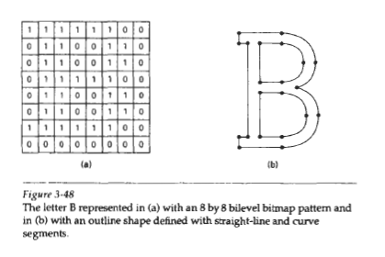
Character Generation:

Slide 45
Character Generation:
Bitmap fonts are the simplest to define and display: The character grid only needs to be mapped to a frame-buffer position. In general, however, bitmap fonts require more space, because each variation (size and format) must be stored in a
font cache. It is possible to generate different sizes and other variations, such as bold and italic, from one set, but this usually does not produce good results.
In contrast to bitmap fonts, outline fonts require less storage since each variation does not require a distinct font cache. We can produce boldface, italic, or different sizes by manipulating the curve definitions for the character outlines. But it does take more time to process the outline fonts, because they must be scan converted into the frame buffer.

Slide 46
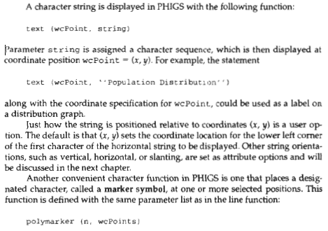
Character Generation:

Slide 47
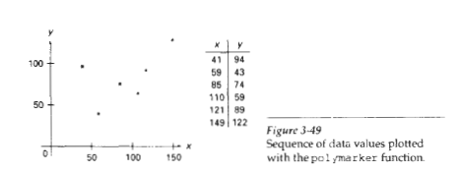
Character Generation:
A predefined character is then centered at each of the n coordinate positions in the list wcpoints. The default symbol displayed by polymarker depends on the particular implementation, but we assume for now that an asterisk is to be used. Figure 3-49 illustrates plotting of a data set with the statement
polymarker (6, wcpoints)

Slide 48
Attributes of Output Primitives
Any parameter that affects the way a primitive is to be displayed is referred to as an attribute parameter. Some attribute parameters, such as color and size, determine the fundamental characteristics of a primitive. Others specify how the primitive is to be displayed under special conditions. Examples of attributes in this class include depth information for three-dimensional viewing and visibility or detectability options for interactive object-selection programs.
Here, we consider only those attributes that control the basic display properties of primitives, without regard for special situations. For example, lines can be dotted or dashed, fat or thin, and blue or orange. Areas might be filled with one color or with a multicolor pattern. Text can appear reading from left to right, slanted diagonally across the screen, or in vertical columns. Individual characters can be displayed in different fonts, colors, and sizes. And we can apply intensity variations at the edges of objects to smooth out the raster stairstep effect.

Slide 49
Attributes of Output Primitives
With GKS and PHIGS standards, attributes settings are accomplished with separate functions that updates a system attribute list.
Four types of attributes:
Line Attribute
Color And Grayscale Level Attribute
Area Fill Attribute
Character Attributes

Slide 50
Line Attribute
There are three basic Line Attributes :
Line type (Solid, Dashed, Dotted)
Line width
Line color
A dashed line could be displayed by generating an interdash spacing that is equal to the length of the solid sections. Both the length of the dashes and the interdash spacing are often specified as user options. A dotted line can be displayed by generating very short dashes with the spacing equal to or greater than the dash size. Similar methods are used to produce other line-type variations.

Slide 51
1. Line Types:

Slide 52
Line Width :
The implementation of line width option depends on the capabilities of the output devices.
In Raster Scan, a standard width is generated with single pixel at each sample position.
In raster scan, the lines of width > 1 are drawn by plotting the additional pixel which are adjacent to the line.
If the width is 2, the line with (x,y) values is drawn with one more line with (x,y+1) values.
If lw is greater than 2, we select alternatively, the lines to right and left of the standard line.

Slide 53
Problems:
The horizontal and vertical lines can be perfectly drawn, but the diagonal lines will be drawn thinner.
Another problem is that the shape of line at the ends is horizontal or vertical regardless of the slope of the line.
Solution:
We can adjust the shape of line ends by using the line caps.

Slide 54
Line caps: Three types of line caps.
Butt cap
Round cap
Projection square cap
Butt cap: Butt cap is obtained by adjusting the end position of the component parallel lines, so that the thick line is displayed with square ends that are perpendicular to the line path.
Round cap : Obtained by adding a filled semicircle to each butt cap. The circular arcs are centered on the line endpoints and have a diameter equal to the line thickness.
Projecting square cap: Obtained by extending the line, and adding butt cap That are positioned one-half of the line width beyond the specified endpoints.

Slide 55
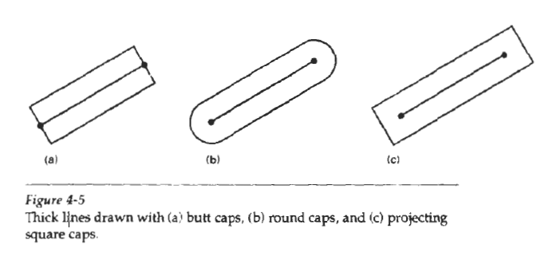

Slide 56
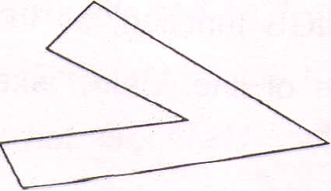
Displaying thick lines using horizontal and vertical pixel spans, leaves pixel gaps at the boundaries between lines of different slopes where there is a shift from horizontal spans to vertical spans.
When two thick lines are intersecting, then also we may want to set the join into required shape. The three types of joins are as below:
1. Miter join
2. Round join
3. Bevel join
1. Miter join: Accomplished by extending the outer boundary of each of the two line until they meet.

Slide 57
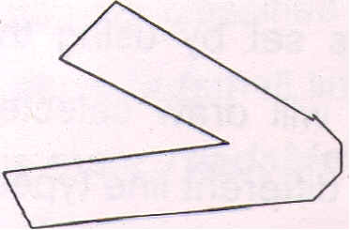
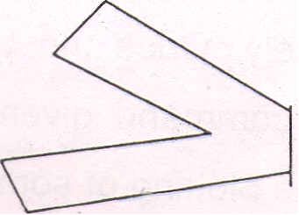
2. Round join: It is produced by capping the connection between the two segments with a circular boundary whose diameter is equal to the line-width.
3. Bevel join: It is generated by displaying the line segment with butt caps and filling the triangular gap where the segments meet.

Slide 58
3. Line color : When a system provides color (or intensity) options, a parameter giving the current color index is included in the list of system-attribute values. A polyline routine displays a line in the current color by setting this color value in the frame buffer at pixel locations along the line path using the setpixel procedure. The number of color choices depends on the number of bits available per pixel in the frame buffer.

